Slide 1

German Energy Prices
A Time Series Analysis of German Wholesale Electricity
Time Series Analysis Seminar
VWL VI
SS 2026
Dr. Stammann

Slide 2
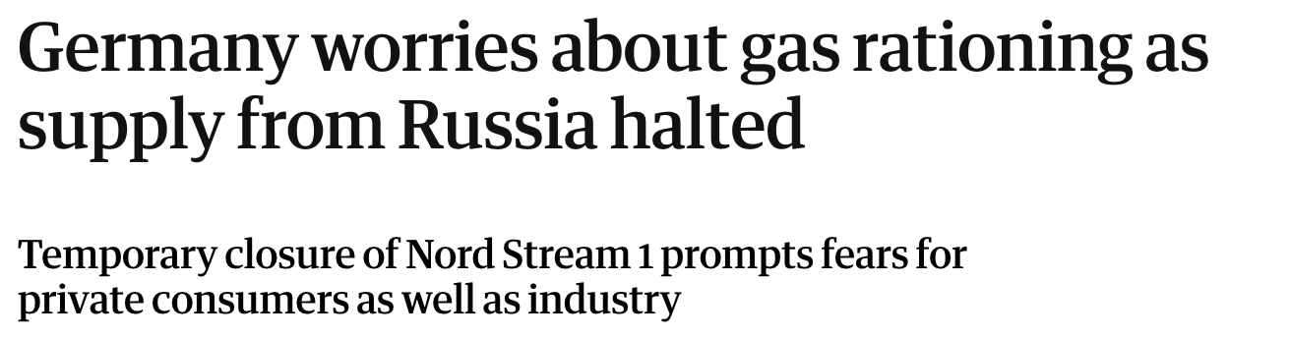
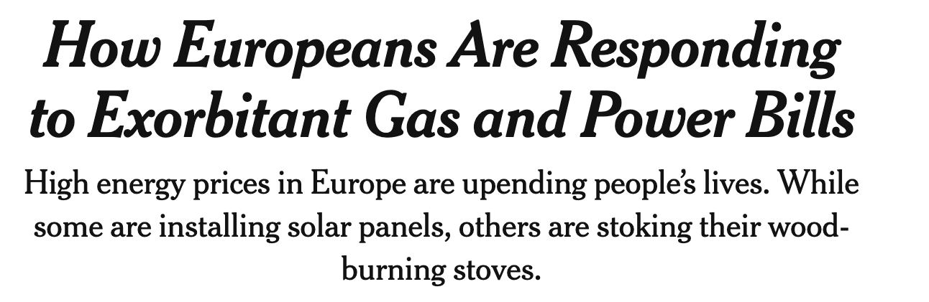
Introduction I Overview
Economic Motivation
Households and companies are affected by energy prices
Effect on daily lives
Some investment decisions rely on assumptions about energy prices
Personal Motivation
Current events motivate discussion about reliance on global energy supplies
Geopolitical leverage through dependence on energy prices
Unpredictable energy prices may drive renewable energy adoption
Source: Oltermann, P. (2022). "Germany worries about gas rationing as supply from Russia halted." The Guardian. https://www.theguardian.com/world/2022/jul/19/germany-worries-about-gas-rationing-as-supply-from-russia-halted
Source: Eddy, M., & Alderman, L. (2022). "How Europeans Are Responding to Exorbitant Gas and Power Bills." The New York Times. https://www.nytimes.com/issue/todayspaper/2022/02/22/todays-new-york-times?eafs_enabled=false
1
Notes:
Time Series Analysis based Arbitrage – Buy cheap energy to sell more expensive later Possible for households with battery storages connected to the grid
Companies and households are exposed to energy prices

Slide 3
Introduction I Overview
Methodology
Time Series Analysis in R: German/Luxemburg Wholesale Energy Price Series
Methodology based on Metcalfe & Cowpertwait Book on Time Series Analysis.¹
Structure
1
Decomposition
2
Autocorrelation and Residuals
3
Forecasting
Research Question
4
GARCH
5
Limitations & Outlook
1 Cowpertwait, P. S. P., & Metcalfe, A. V. (2009). Introductory time series with R. Springer.
2

Slide 4
Preliminary Research Question
Does including the 2022 energy crisis period degrade forecast accuracy of energy prices and does the same hold for countries relying on different primary energy consumption patterns?
4

Slide 5
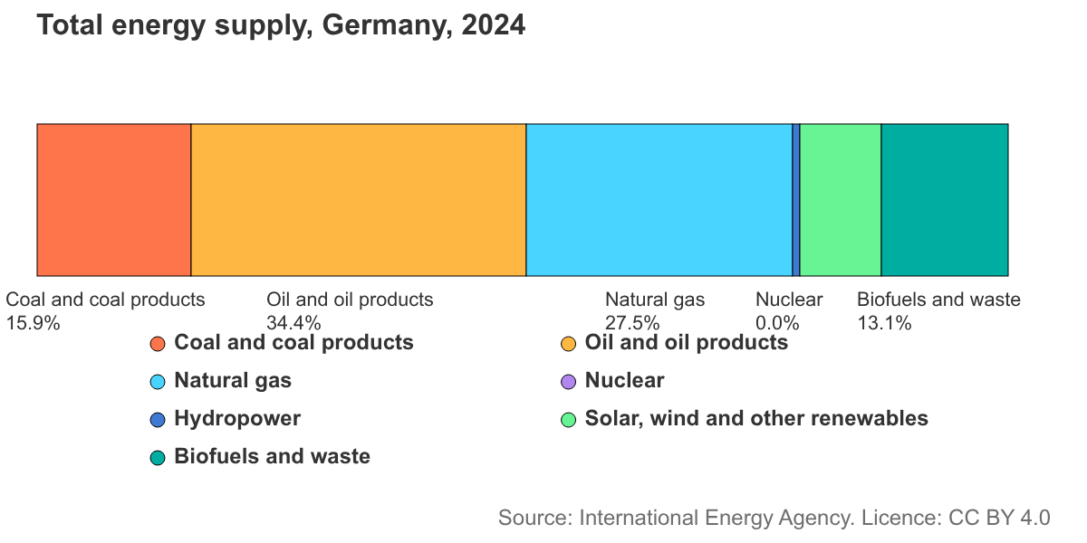
Introduction I German Energy Overview
Energy in Germany
Prior to February 24th, 2022
Reliance on natural gas imports from Russia
Russian Invasion fueled energy price crisis
Similar energy price movements & crisis in other European countries
Total Yearly German Energy Demand:
476.000.000 MWh¹
> cor(weeklyDE, weekly$`Frankreich [€/MWh]`)
[1] 0.9647013
> cor(weeklyDE , weekly$`Österreich [€/MWh]`)
[1] 0.9897348
> cor(weeklyDE, weekly$`Norwegen 2 [€/MWh]`)
[1] 0.9529006
Average Consumption:
3.5 MWh/ year
2-Person Household
Average Yearly Costs:
1150 – 1450 €/ year
2-Person Household
Graph: International Energy Agency. Germany: Energy Mix. https://www.iea.org/countries/germany/energy-mix, accessed July 4, 2026.
^{1 ibid.}
3
Notes:
Reliance on natural gas imports from Russia caused

Slide 6


Data I Overview
Data Source
SMARD Electricity and Gas Market Data ¹
Federal Bureau for Grids and Energy Systems (Bundesnetzagentur)
Provides granular energy price data for monthly, weekly, hourly and 15-minute intervals
German and Luxembourg Wholesale Prices per MWh [€/MWh]
NA’s
0
Observations
379
Min. Median Mean Max.
11.19 73.85 93.23 585.92
> head(weekly[ "Deutschland/Luxemburg [€/MWh]")], 3)
`Deutschland/Luxemburg [€/MWh]`
1 51.4
2 54.5
3 64
1 Bundesnetzagentur. SMARD: Electricity and gas market data.
2 Statistisches Bundesamt. (2023). Stromverbrauch der privaten Haushalte nach Haushaltsgrößenklassen.
5

Slide 7
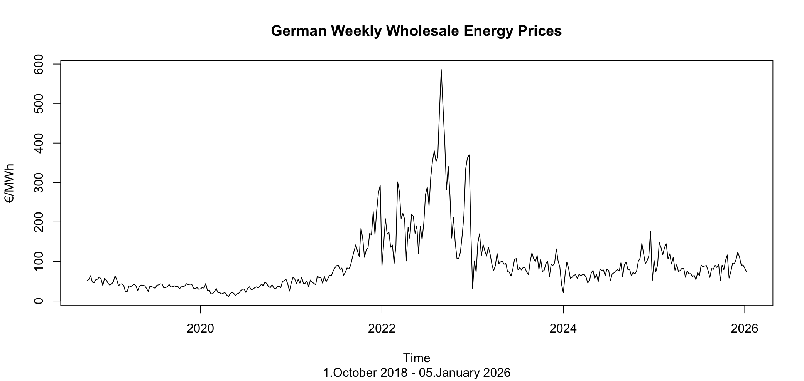
Data I Energy Price Series
Wholesale Energy Price Series
Energy Price Crisis after Russian invasion of Ukraine
6
Notes:
It should be noted that other cutoffs could be used. When testing those, the exclusion of a number of countries with around 99% would have led to a diminishing number of observations.

Slide 8
Data I Selection & Choices
Assumptions
Reasoning
Time Series starting 1.10.2018
Change of Price Regions from GER/LUX/AUS to GER/LUX¹
Weekly Price Data
Avoids daily noise and preserves visibility of seasonality
German Wholesale Prices
Household energy prices depend on provider
Frequency = 52
Simplification, instead of approx. 52.18 weeks/year
Log transformed prices
Stabilises variance and normalizes large spikes & differences
2 Bundesnetzagentur. Engpassbewirtschaftung an der Grenze zu Österreich. SMARD.
7

Slide 9
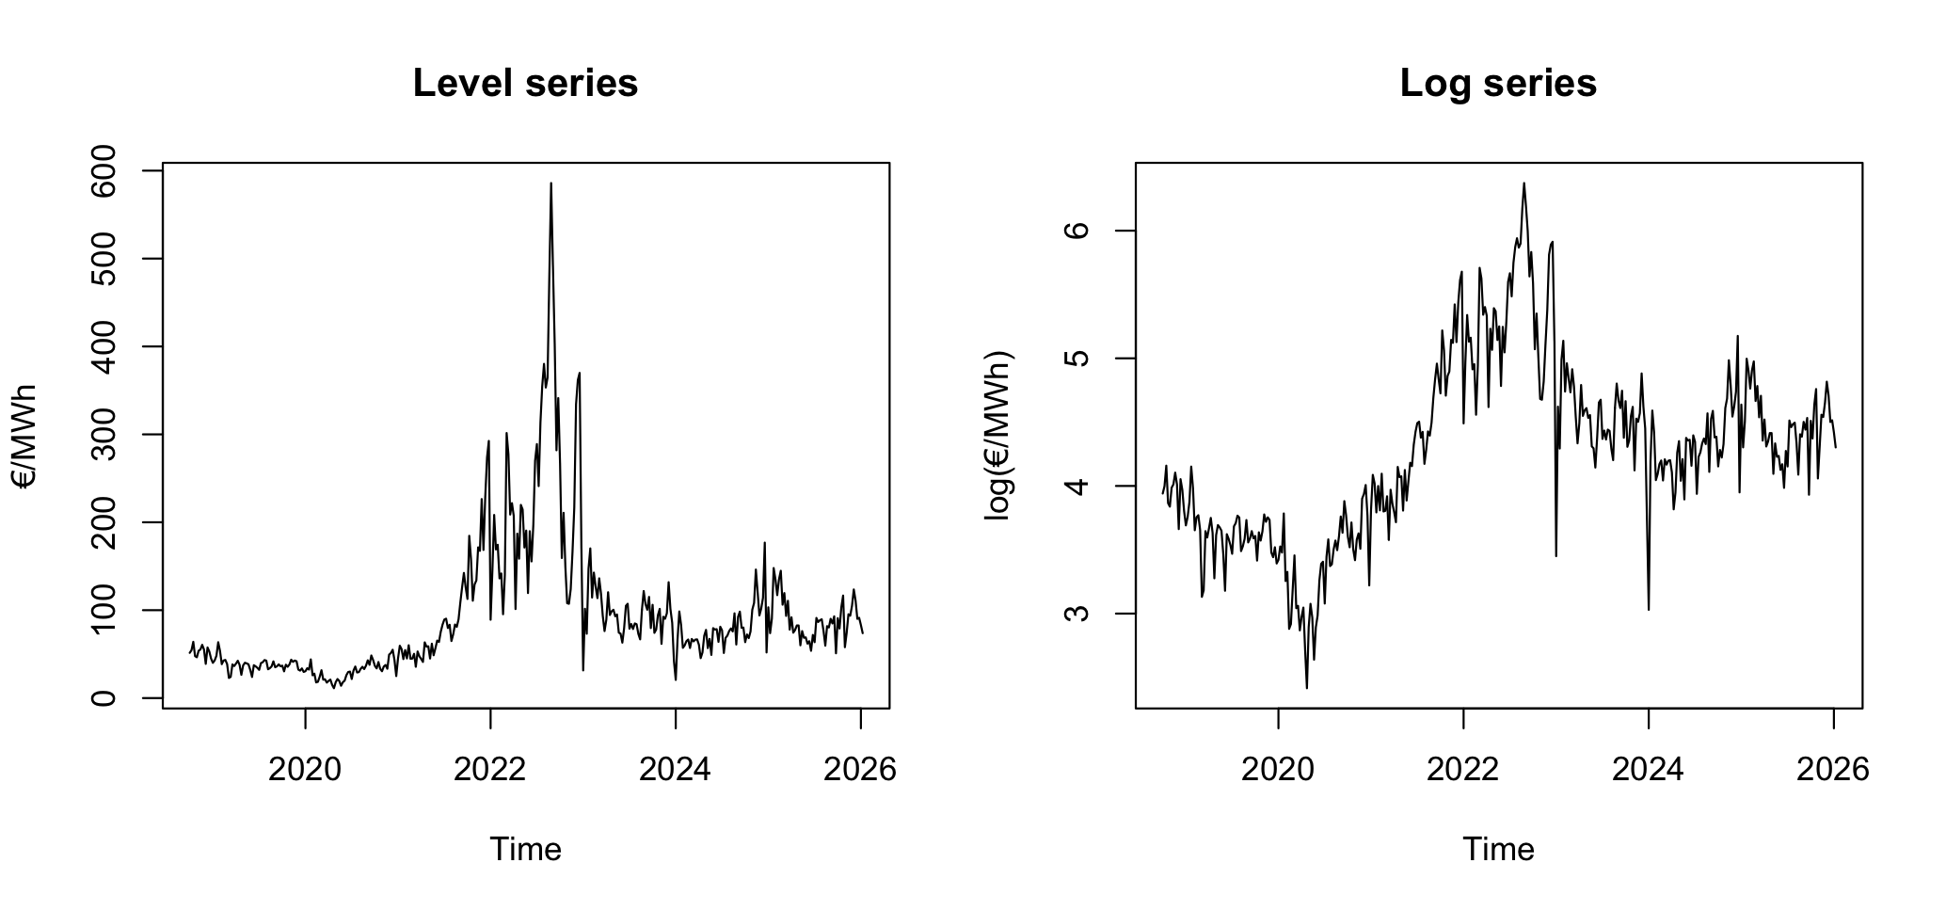
Decomposition I Energy Price Series
Log- Transformed Series Comparison
8
Notes:
The series ranges from ~50 to ~700 EUR/MWh, so the variance grows with the level. The book stabilizes another electricity time series of this kind of series by taking logs: the book uses log(Elec.ts)

Slide 10
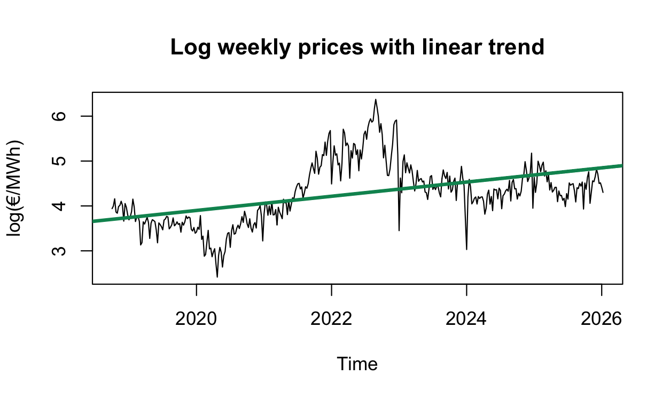
Linear Regression I Overview & Interpretation
Theoretical Interpretation
C.p. every year electricity price increases by 17.2 %.
Limitation
Slope is driven by crisis period after Russian invasion
Lacks explanatory power and forecasting quality
=========================================
Dependent variable:
---------------------------------------
log(Weekly electricity price)
-----------------------------------------------------------------------
Time 0.15840
(0.01494)
p = 0.00000
Constant -316.06668
(30.20782)
p = 0.000
-----------------------------------------------------------------------
Observations 379
R2 0.2298
Adjusted R2 0.2277
=========================================
Note: *p<0.1; **p<0.05; ***p<0.01
9

Slide 11
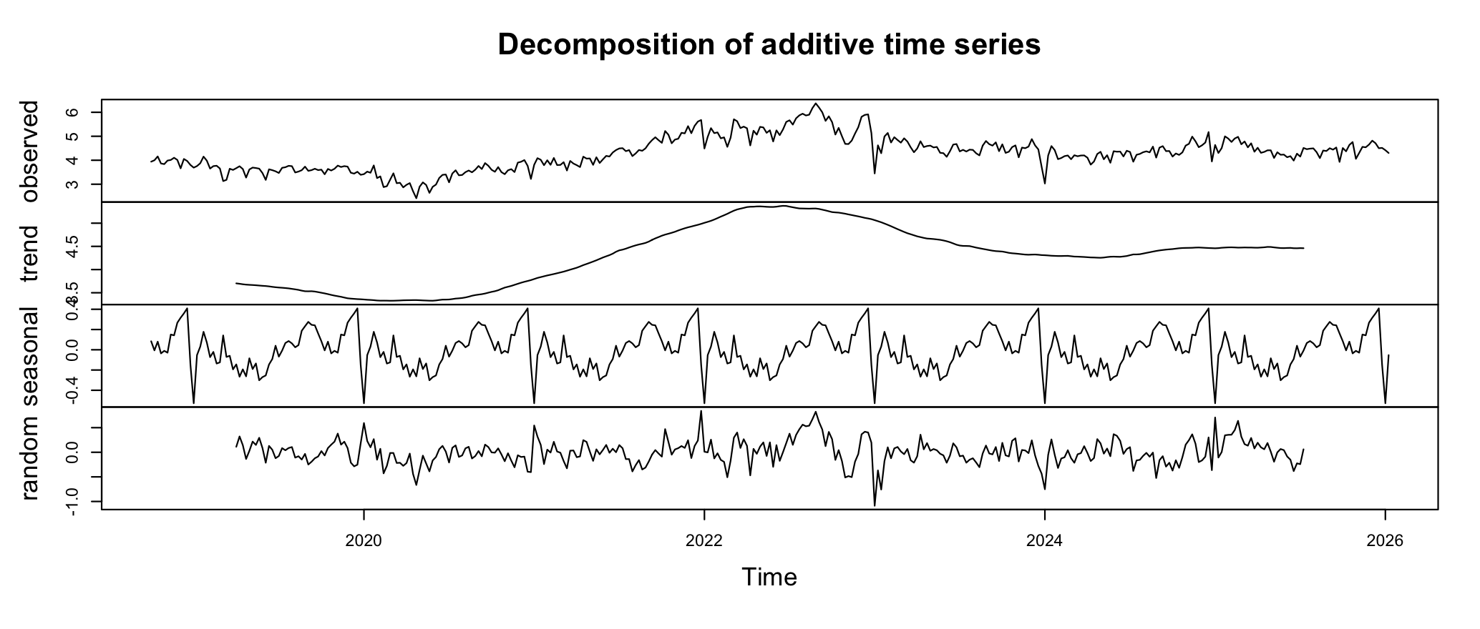
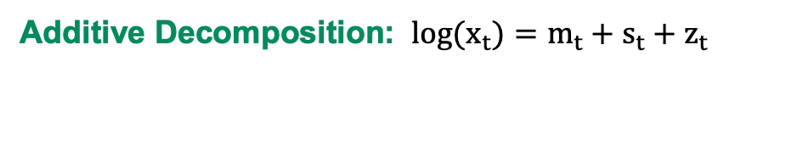
Decomposition I Approach
Additive Decomposition: $log(x_{t})=m_{t}+s_{t}+z_{t}$
where, at time t, log(x_{t}) is the log-transformed energy price series, m_{t} is the trend, s_{t} is the seasonal eﬀect, and z_{t} is an error term that is a sequence of correlated random variables with mean zero.
10
Notes:
It should be noted that other cutoffs could be used. When testing those, the exclusion of a number of countries with around 99% would have led to a diminishing number of observations.

Slide 12
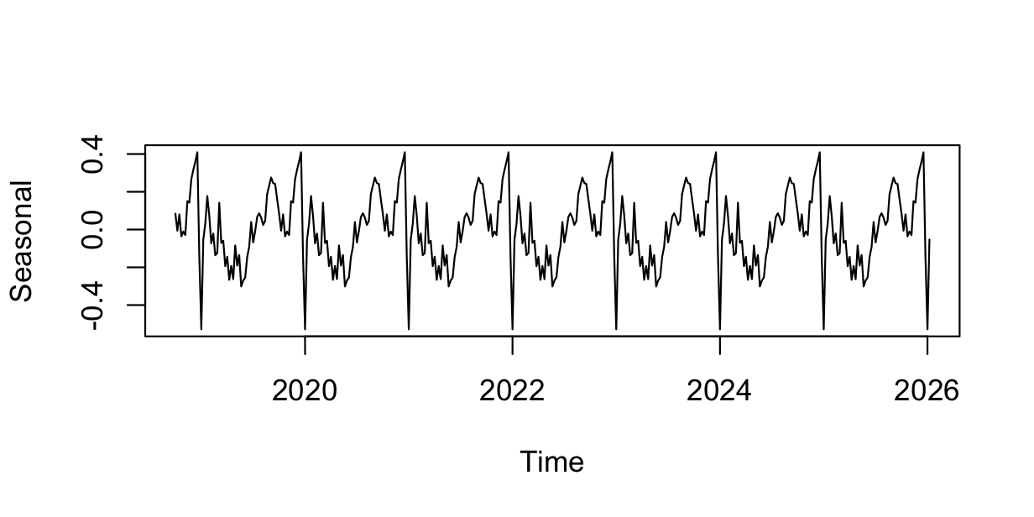
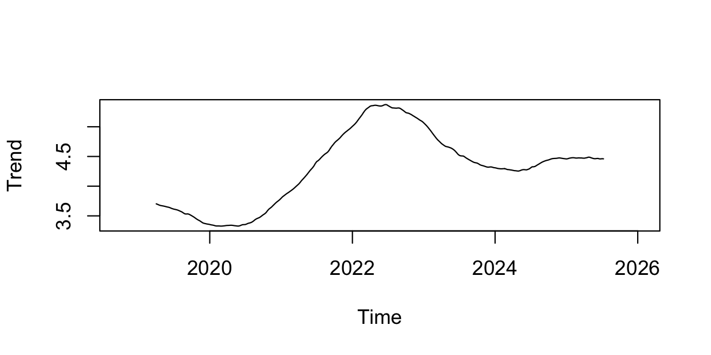
Decomposition I Seasonal & Trend Component
Seasonal Component
Presence of annual recurring patterns
winter peak demand, summer low demand
renewable generation cycles
energy system-stress periods
Trend Component
Clear trend distortion during energy price crisis as a result of the Russian invasion of Ukraine.
Pre-/post-crisis levels far below crisis peak
11

Slide 13
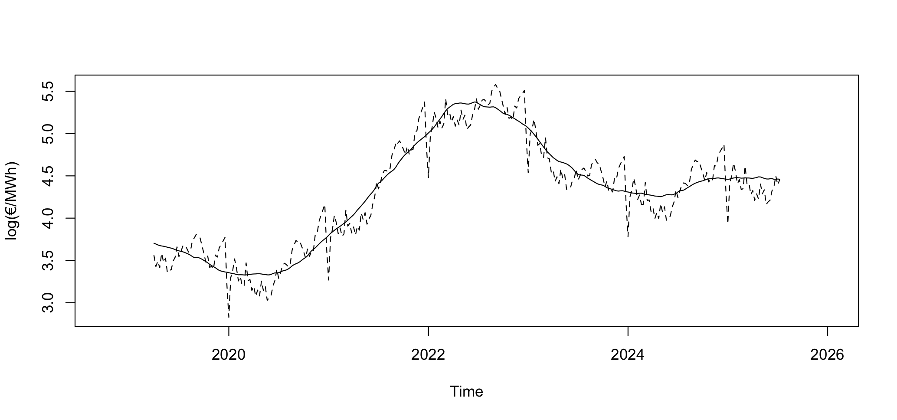
Decomposition I Seasonal & Trend Component
Trend and Trend + Seasonal Plot
Seasonal effect is small relative to the trend
12
Notes:
It should be noted that other cutoffs could be used. When testing those, the exclusion of a number of countries with around 99% would have led to a diminishing number of observations.

Slide 14
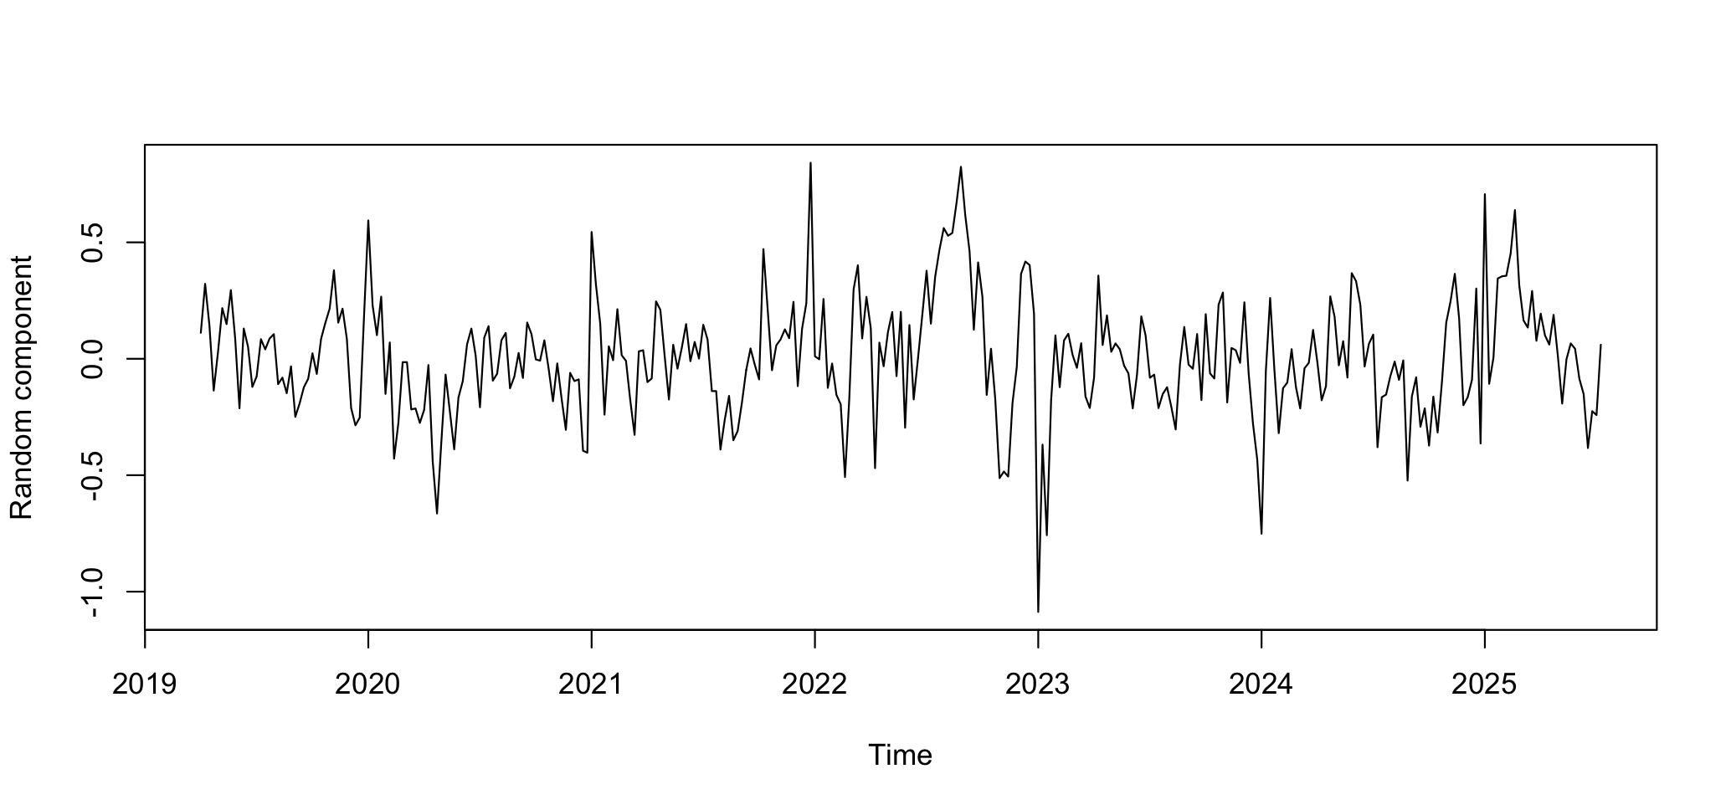
Decomposition I Random Component
Random Component
Spikes during German energy crisis after Russian invasion
13
Notes:
It should be noted that other cutoffs could be used. When testing those, the exclusion of a number of countries with around 99% would have led to a diminishing number of observations.

Slide 15
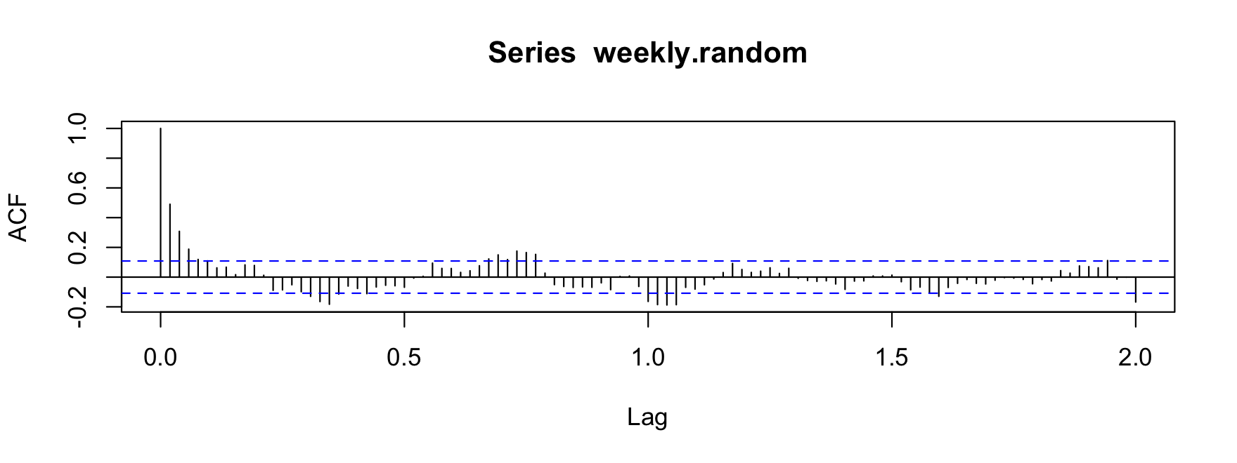
Autocorrelation I Overview
Autocorrelation in Random Component
Not white noise, autocorrelation at lag 1 and 2
Weekly, annual autocorrelation
Short-run weekly autocorrelation
> #Autocorrelation current week and previous week: [2]
> acf(weekly.random)$acf[2]
[1] 0.4901079
> #Autocorrelation current week and one month earlier: [5]
> acf(weekly.random)$acf[5]
[1] 0.1187632
14
Notes:
The autocorrelation decays quickly - a lag-1 around 0.49, gone within three or four lags - with only faint bumps near the annual lags (the ~0.7 and ~1.0 region on the year-scaled axis)
Even on the 2 year horizon, there is some significant, yearly autocorrelation spikes that remain

Slide 16
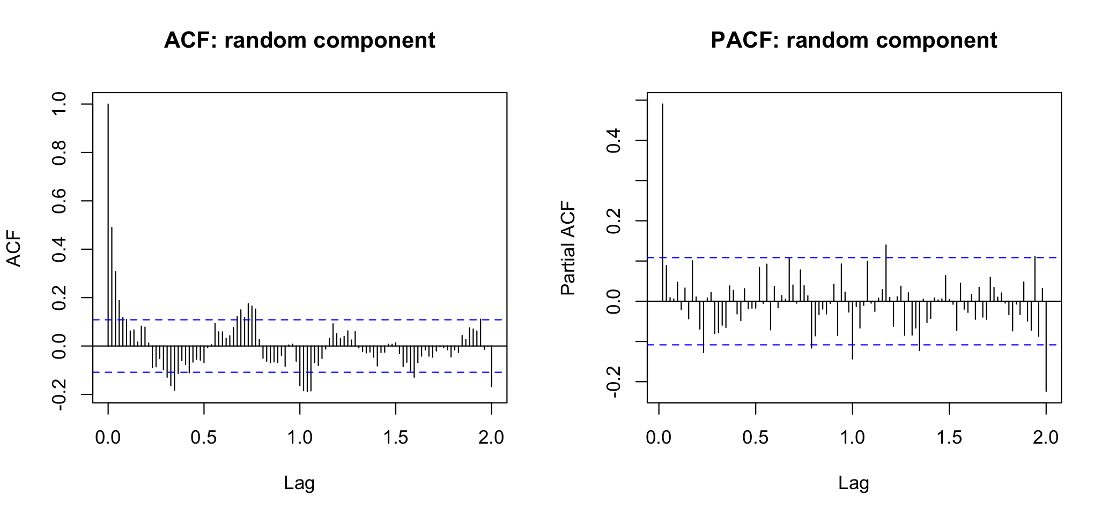
Autocorrelation I Overview
ACF and PACF Overview
15

Slide 17
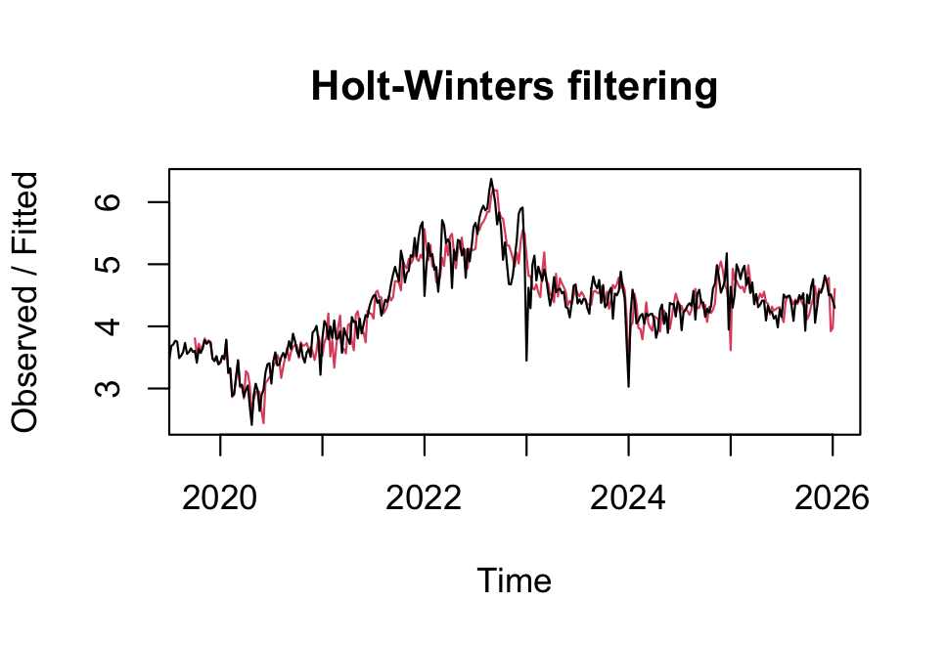
Forecasting I First Approach
Holt-Winters Approach
Baseline estimation model
Unlikely to fit given large trend component in series
Key Problem of the series:
Crisis trend influence make forecasting more complex
Preliminary Insights
Weekly price remain relevant
Annual weekly seasonality
Call:
HoltWinters(x = weekly.ts, seasonal = "additive")
Smoothing parameters:
alpha: 0.3914396
beta : 0.002800409
gamma: 0.4574828
16

Slide 18
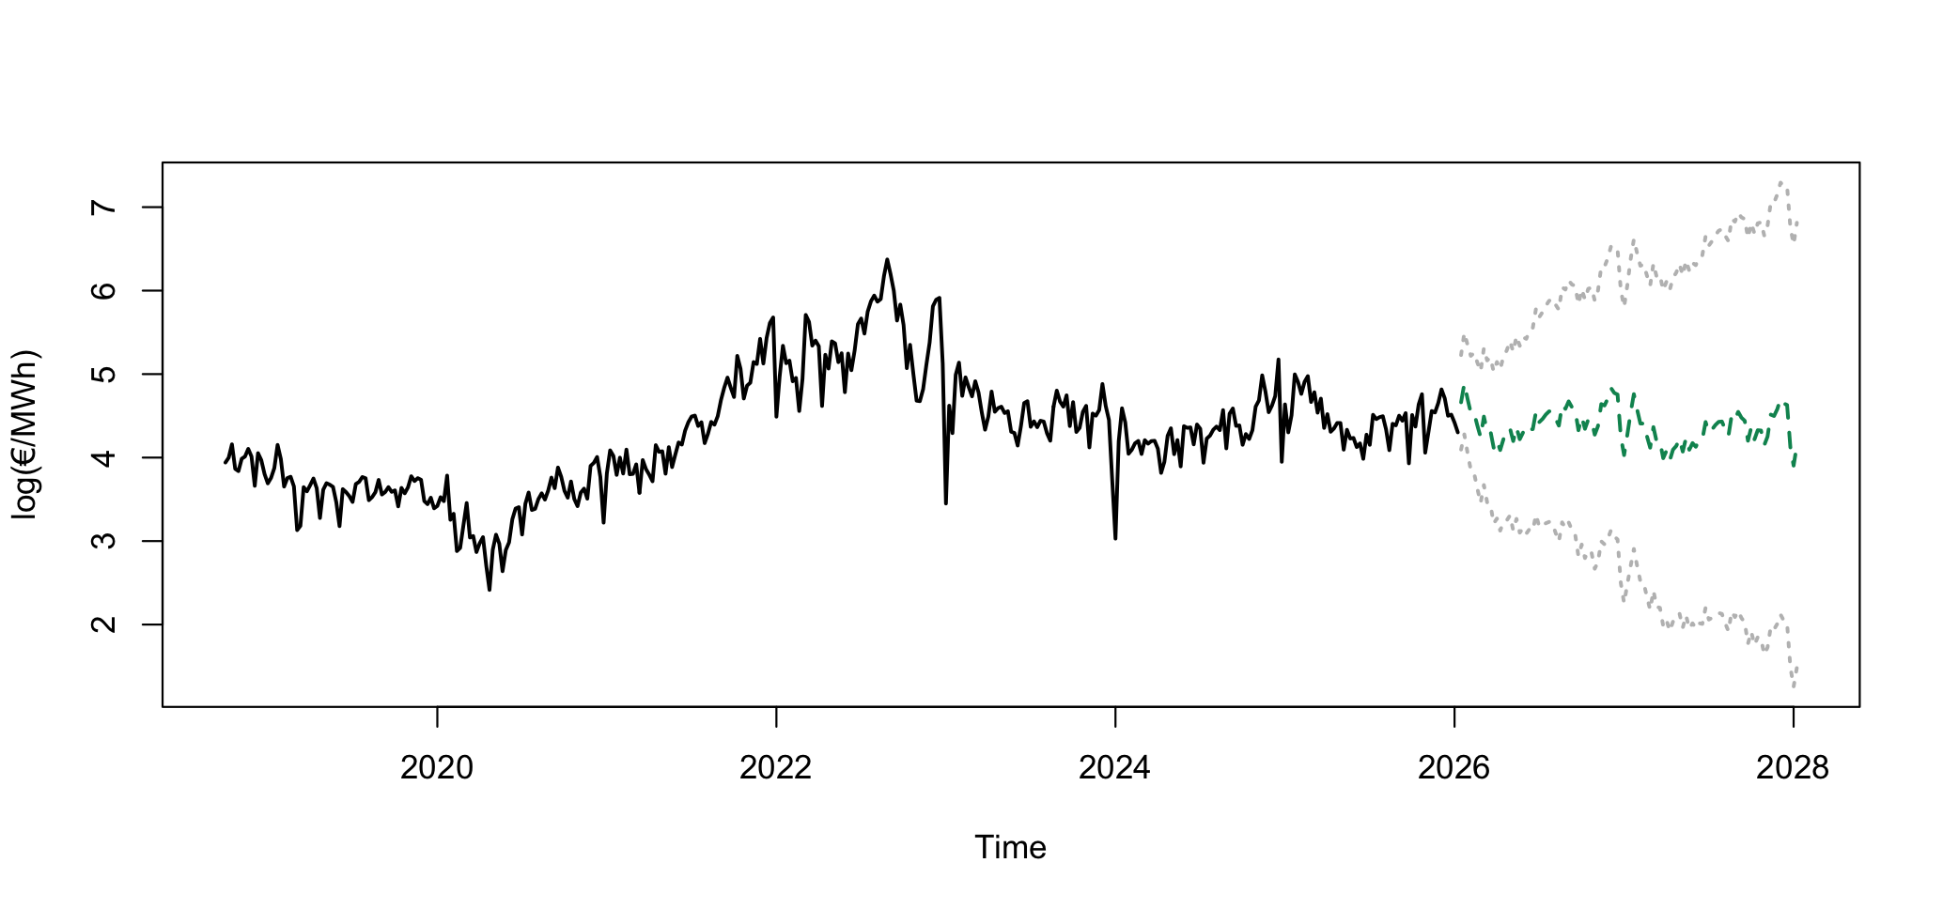
Forecasting I Plot
Holt-Winter 2 Year Prediction
17

Slide 19
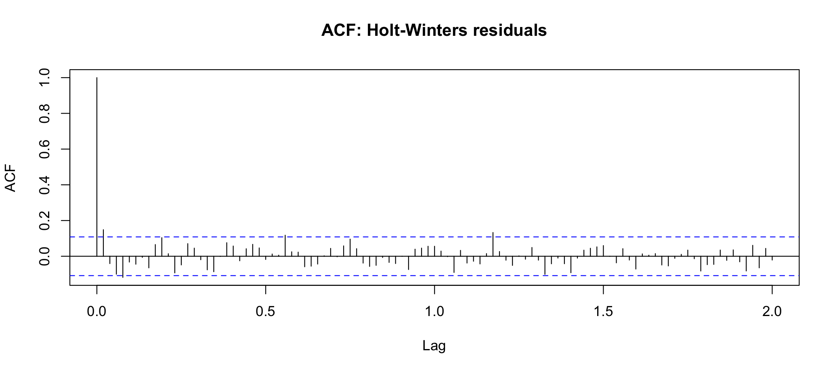
Forecasting I Plot
ACF of Holt-Winters residuals
Not completely white noise structure
Some autocorrelation remains in Holt-Winters residuals
18

Slide 20
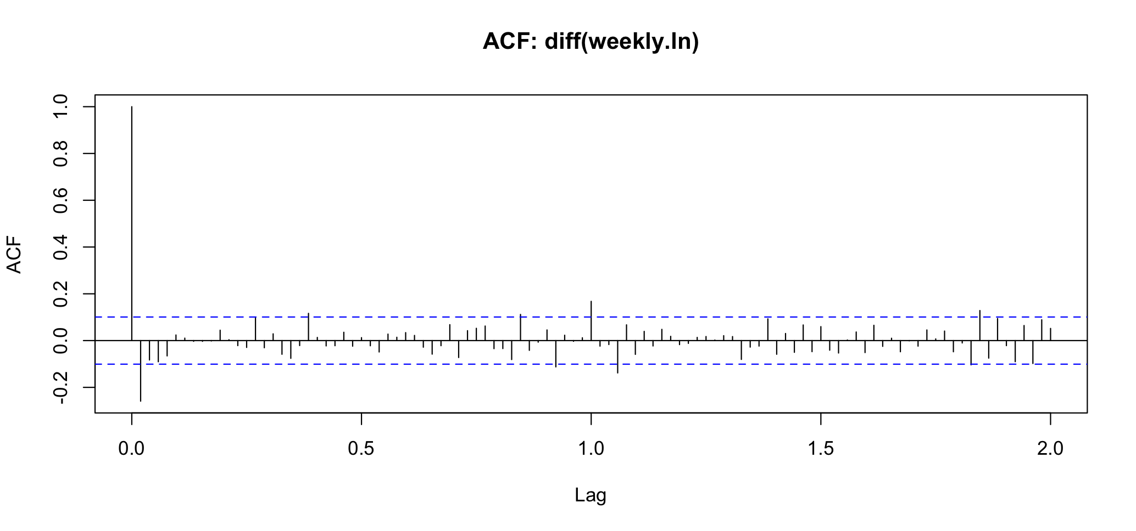
Forecasting I First Approach
Checking Suitability: Random Walk
Little autocorrelation in differenced series
Closer to white noise
19
Notes:
→ d=1.

Slide 21
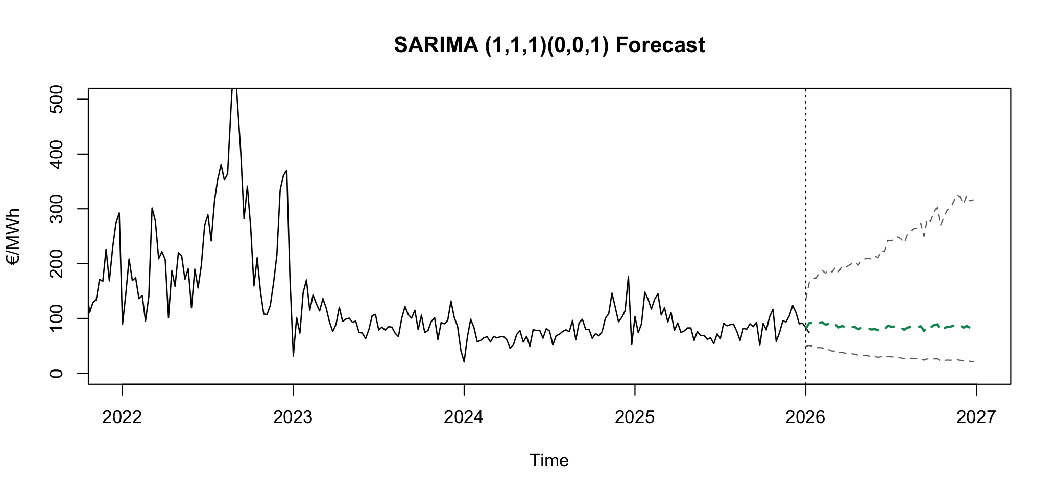
SARIMA I Forecast Plot
21

Slide 22
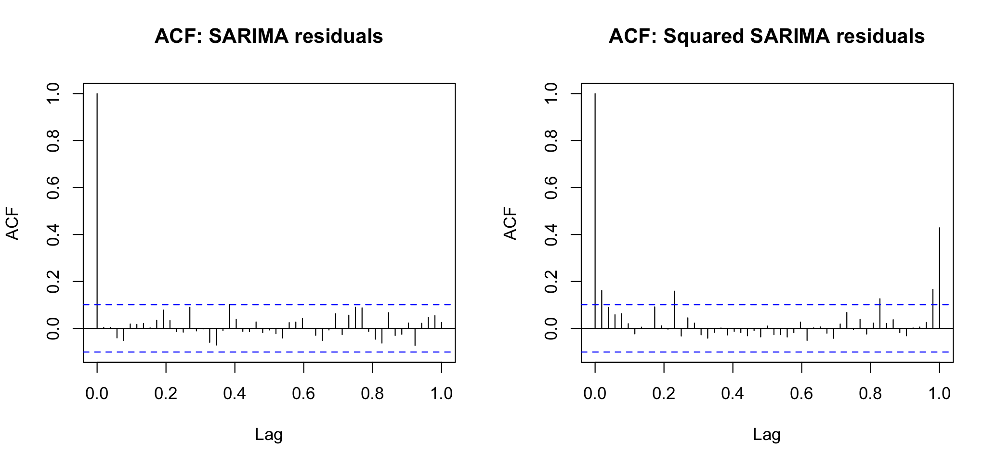
SARIMA I SARIMA ACF Plots
No significant autocorrelation remains
Significant autocorrelation at short lags
Volatility clustering
22
Notes:
SARIMA adequately captures the conditional mean
4

Slide 23
GARCH I Overview
GARCH Model
Fitting GARCH on residuals of SARIMA
a1 significant
Volatility clustering
b1 confidence interval crosses zero
No evidence of persistent volatility shocks
Volatility reacts strongly to shocks but does not persist
Short volatility spikes as a result of energy crisis instead of lasting „high-volatility regime“
> confint(weekly.garch)
2.5 % 97.5 %
a0 0.01296059 0.04727727
a1 0.22812916 0.44726687
b1 -0.08192586 0.52336389
23
Notes:
The book is careful: if the variance grows with the trend (as in the airline/electricity series), that's ordinary heteroskedasticity, which you fix with a log. If the variance is correlated in time — quiet periods and violent periods clustering — that's conditional heteroskedasticity / volatility, which needs GARCH. That distinction is precisely your two-step story: the log handled the level-scaling heteroskedasticity, and GARCH handles the remaining clustering.

Slide 24
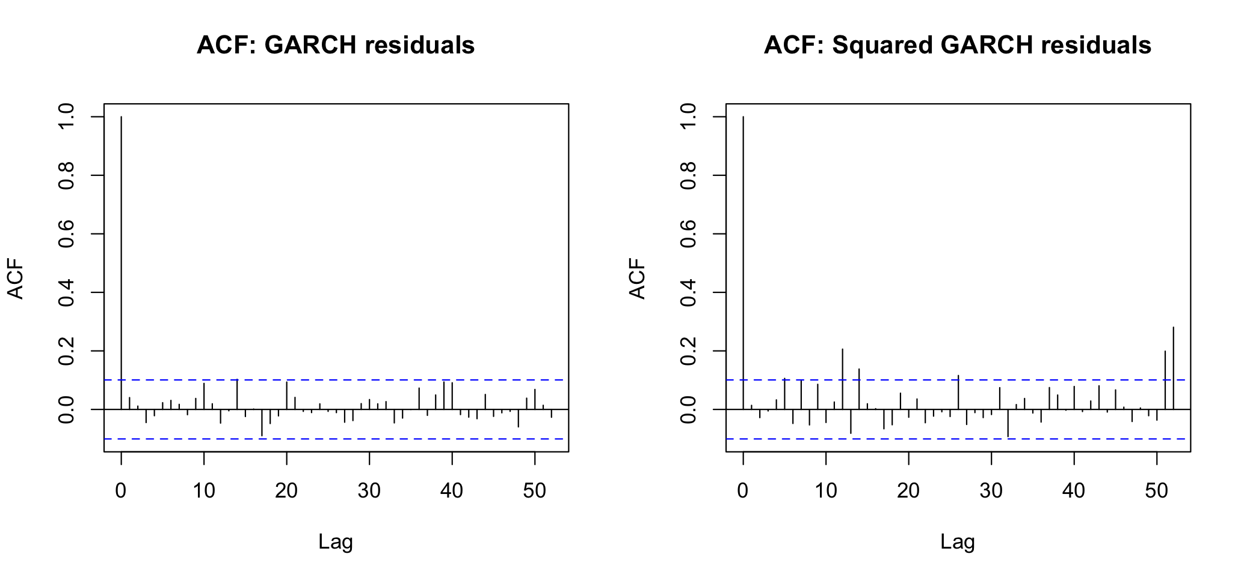
GARCH I ACF Residual Plot
24
Notes:
ability to finance, maintain, and utilize massive projects typically requires a certain level of economic maturity.

Slide 25
Limitations I Final Considerations
Limitations
Series limited to 379 observations
No current data of price and volatility spike
Choice of forecast training window
Forecast testing window has effect on accuracy and results of the forecast
Annual volatility spikes remain
Long Memory Processes from Book, Chapter 8
Continuous seasonal autocorrelation at lag = 52
ACF of Squared GARCH residuals
Add Seasonal GARCH or P-GARCH
25
Notes:
Ideally, the model would include the rural population density. This variable is hard to extract from the variables that are given in the world bank database. IV might suffer from some form of selection bias.

Slide 26
Outlook I Final Considerations
Next Steps
Compare with countries with higher renewable share and different primary energy consumption mix
Norway
Largest share of hydropower generation
42.8% Hydropower generation
Different seasonal component structure due to energy consumption patterns
Do other kinds of primary energy supplies create more precise forecasts by limiting price fluctuations?
Graph: International Energy Agency. Norway: Energy Mix. https://www.iea.org/countries/norway/energy-mix, accessed July 9, 2026.
26

Slide 27
Sources
Bundesnetzagentur. SMARD: Electricity and gas market data. https://www.smard.de/home, accessed June 23rd,2026.
Eddy, M., & Alderman, L. (2022). "How Europeans Are Responding to Exorbitant Gas and Power Bills." The New York Times. https://www.nytimes.com/2022/02/21/business/europe-power-gas-bill.html?eafs_enabled=false, accessed June 28th, 2026.
Oltermann, P. (2022, July 19). Germany worries about gas rationing as supply from Russia halted. The Guardian. https://www.theguardian.com/world/2022/jul/19/germany-worries-about-gas-rationing-as-supply-from-russia-halted, accessed June 28th, 2026.
Statistisches Bundesamt. (2023, September 27). Stromverbrauch der privaten Haushalte nach Haushaltsgrößenklassen. https://www.destatis.de/DE/Themen/Gesellschaft-Umwelt/Umwelt/UGR/private-haushalte/Tabellen/stromverbrauch-haushalte.html
International Energy Agency. Norway: Energy Mix. https://www.iea.org/countries/norway/energy-mix, accessed July 9th, 2026.
International Energy Agency. Germany: Energy Mix. https://www.iea.org/countries/germany/energy-mix, accessed July 4th, 2026.
27
Notes:
Ideally, the model would include the rural population density. This variable is hard to extract from the variables that are given in the world bank database. IV might suffer from some form of selection bias.

